Slide 1

CSE- 321
Software Engineering
Lecture : 03 Introduction (Cont.)
Fahad Ahmed
Lecturer, Dept. of CSE
E-mail: fahadahmed@uap-bd.edu

Slide 2
Lecture Outlines
Classification of Software
What is Software Engineering?
Importance of Software Engineering
Program vs Software Product
Software Engineering vs System Engineering
Software Process
Software Process Model
Key Challenges Facing Software Engineering
Software Engineering Ethics

Slide 3
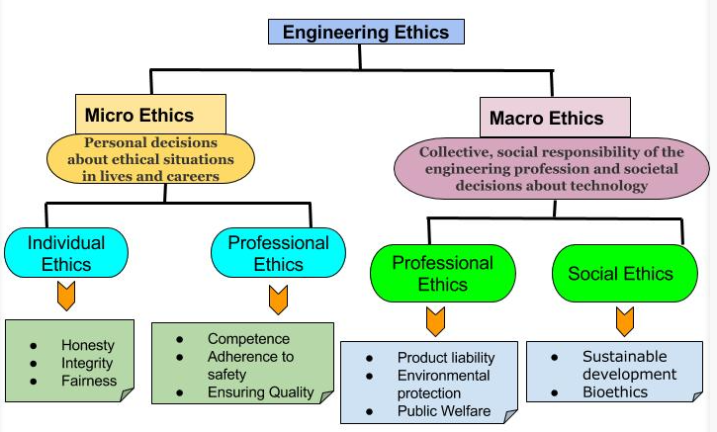
Software engineering ethics
https://iesgeneralstudies.com/ethics-in-engineering-profession/

Slide 4
Codes of Ethics
Codes of ethics vary from one professional society to another, but they typically share common features in prescribing the responsibilities of engineers to the public, their employers and clients, and their fellow engineers.
All modern codes state that the most significant responsibility of engineers is to protect the public health, safety and welfare.
They are not legally binding – an engineer cannot be arrested for violating an ethical code, but may be expelled from or censured by the engineering society.

Slide 5
Codes of Ethics
The IEEE Code of Ethics, implemented in 1990, pledges its members
“to accept responsibility in making engineering decisions consistent with the safety, health and welfare of the public, and to disclose promptly factors that might endanger the public or the environment.”
It also commit its members
“to assist colleagues and co-workers in their professional development and to support them in following this code of ethics”

Slide 6
Codes of Ethics
NSPE Code of Ethics (The National Society of Professional Engineers is an American professional association representing licensed professional engineers) says
Hold paramount the safety, health, and welfare of the public.
Perform services only in areas of their competence.
Issue public statements only in an objective and truthful manner.
Act for each employer or client as faithful agents or trustees.
Avoid deceptive acts.
Conduct themselves honourably, responsibly, ethically, and lawfully so as to enhance the honour, reputation, and usefulness of the profession.

Slide 7
Codes of Ethics
What is safety?
Safety means freedom from damage, injury, or risk . Risk is the possibility of suffering harm or loss.
Responsibility of Engineers
Safety should be an integral part of any engineering design
No duty of the engineer is more important than her duty to protect the safety and well-being of the public
Risk is a key element in any engineering design which has to be minimised to the maximum possible extent
How to ensure safety?
The engineering design must comply with the applicable laws
Design must meet the standards of accepted engineering practice
Any design alternatives that are potentially safer must be explored
Risk-Benefit analysis should be done to analyse risk and to determine weather a project should proceed
The engineer must be aware of potential product misuses by the users and the design should be to avoid these misuses
Once the product is designed, both prototypes and devices should be tested

Slide 8
Codes of Ethics
Health
Public health is affected by many factors such as pollution, toxic elements, flawed design etc. So the engineers should
Follow the quality standards, for example, the level of radiation from a cell phone device
Minimise the emissions from industrial process
Minimise the use of toxic materials for end products
Adhere to the pollution standards for air, water, noise etc of the country
Shall be objective and truthful in professional reports, statements, or testimonies
Report to authority any potential risks

Slide 9
Codes of Ethics
Public Welfare
If the standards for safety and health are met, it will add to the public welfare. Apart from those public welfare includes
Identify, define and address ethical, economic, cultural, legal and environmental issues related to work projects
Be objective in issues permits for engineering projects
Avoid illegal activities like hacking and cyber attacks etc
Ensure Quality of services and products
Quality control is a system of maintaining standards in manufactured products by testing a sample of the output against the specification.

Slide 10
Codes of Ethics
Personal Values
The codes of ethics also mention the personal values that an engineer should have. They are
Integrity and honesty
Impartiality, fairness, and equity
Impartiality is a principle of justice holding that decisions should be based on objective criteria, rather than on the basis of bias, prejudice, or preferring the benefit to one person over another for improper reasons.
Fairness is defined as the quality of having an unbiased disposition
Equity is the quality of being fair and impartial
Trust-worthiness
Confidentiality – of certain information belonging to their employer or client
Privacy – important in cyberspace because of the number of personal records are stored on and transferred among computers, where the engineers have access and control
Ethics in Research and Experimentation
Conduct oneself honourably, responsibly, ethically, and lawfully

Slide 11
Codes of Ethics
The professional qualities that the code of ethics mandates are
Competence – the ability to do something successfully or efficiently
Provide service in their areas of competence only, being honest and forthright about any limitations of their experience and education
Strive for high quality, acceptable cost and a reasonable schedule
Accept full responsibility for their own work
Disclose to appropriate persons or authorities any actual or potential danger
Cooperate in efforts to address matters of grave public concern etc
Shall strive for professional development

Slide 12
Codes of Ethics
How do we know what is ethical?
Is it sensible?
Is it desirable?
Will it bring greatest good to greatest number of people?
Will it violates others basic rights?
Use of our own senses to judge the action.

Slide 13
Environmental Ethics and Engineering
Environmental Ethics
Deals with relationship of man with environment.
Some common topics in environmental ethics are
Co-create rules and regulations for the ethical use of technology
green technology
Electric vehicles
Wave energy
Green computing
Wind power
Wind turbine
Solar power
Ocean thermal energy conversion
The concept of Sustainable development
Sustainable development is development that meets the needs of the present without compromising the ability of future generations to meet their own needs.

Slide 14

Thanks to All

